Slide 1

Julia AI
Project Presentation

Slide 2
Topic
Breast Cancer Diagnosis Prediction Using Machine Learning

Slide 3
Introduction
Name: Dhruv Saini
Graphic Era Deemed To be University
Section: ML
University Roll No. : 2015241

Slide 4
Introduction to project
What is Machine Learning?
Machine Learning(ML) is a method of data analysis that automates analytical model building
It is a branch of Artificial Intelligence based on the idea that systems can learn from data, identify patterns and make decisions with being explicitly programmed

Slide 5
Breast Cancer And it’s Treatment
Breast cancer is the most common invasive cancer in women and the second leading cause of cancer death in women after lung cancer.
Breast cancer can occur in both men and women, but it is far more common in women
Treatment –
Surgery
Radiation therapy
Chemotherapy
Hormone blocking therapy

Slide 6

Use of Machine Learning
In this case, we can use machine learning techniques to create such a model that can diagnose the disease based on different factors and features available to us though dataset.

Slide 7
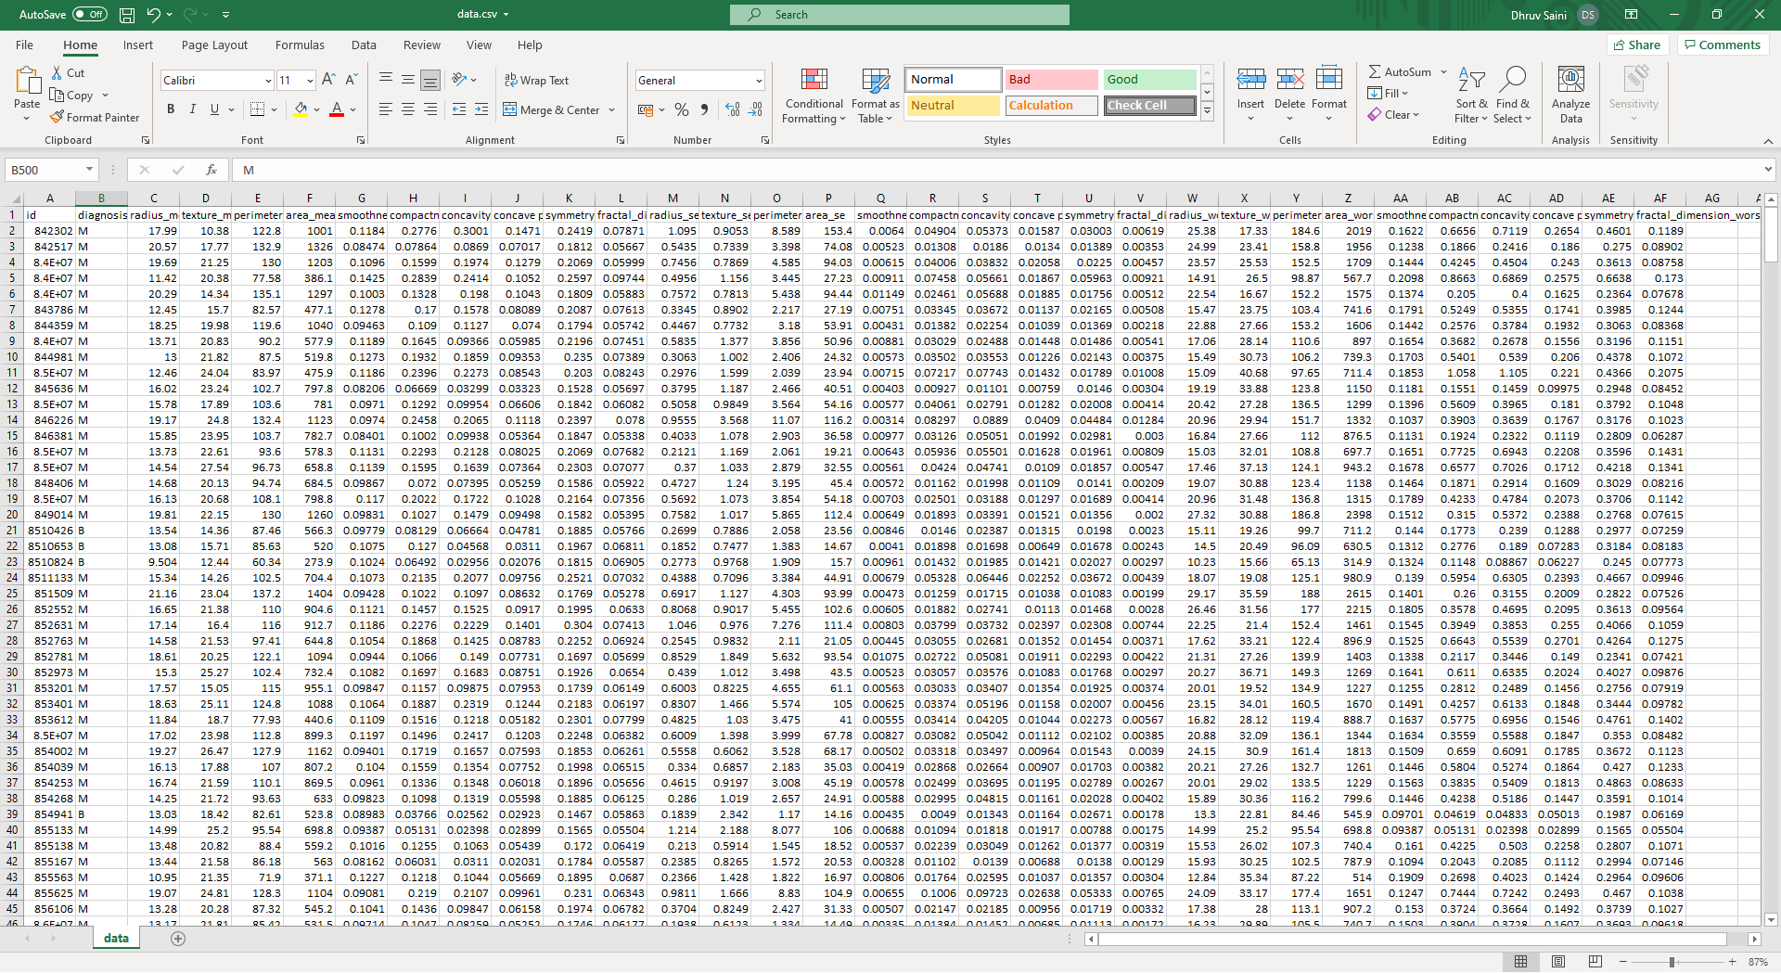
Our Dataset

Slide 8
Dataset Analysis
Our dataset comprise of :
33 different features including diagnosis result.
569 unique records of different patients
0 missing values
Two classes
Malignant: 212
Benign: 357

Slide 9
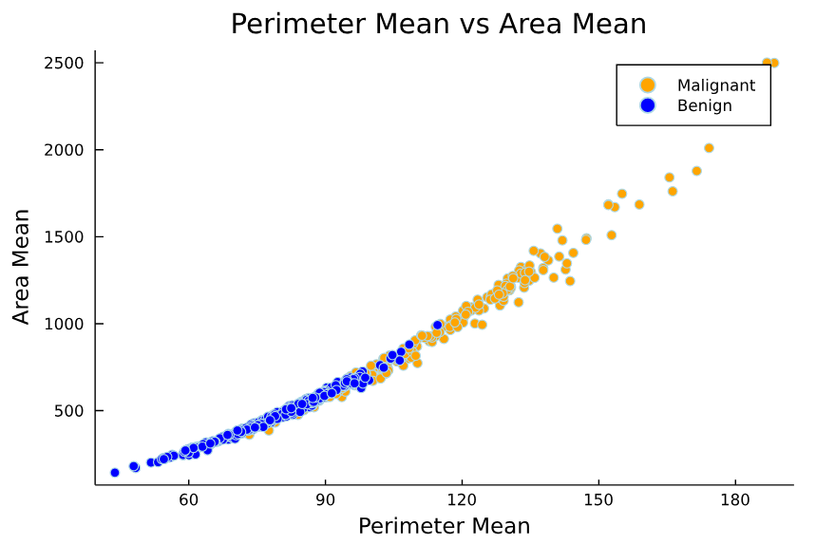
Data Visualization
It is a technique of graphically representing information and data.
To understand data better we have visualized our data into plots and histograms.

Slide 10
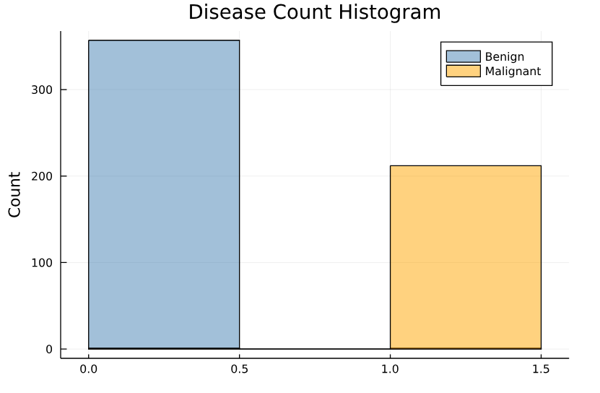
Histogram
Malignant: 212
Benign: 357

Slide 11
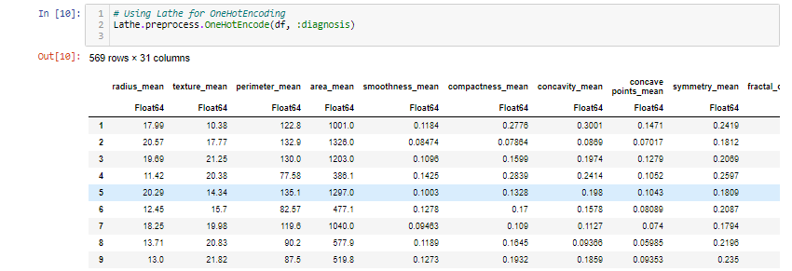
Feature Engineering
OneHotEncode
OneHotEncoding is process by which we convert categorical variable.
In this Strategy, each category value is converted into a new column and assigned a 1 or 0 value to the column.

Slide 12
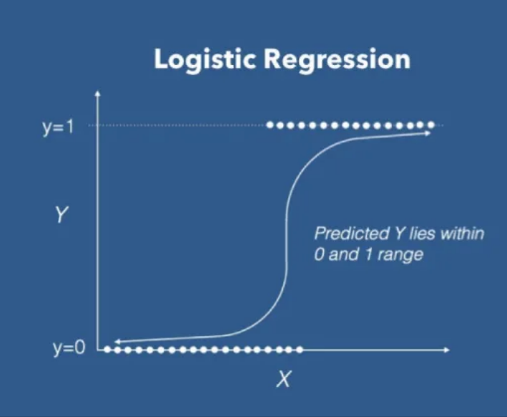
Machine Learning Model
Logistic Regression: It is a supervised machine learning classification algorithm used to predict the probability of the target variable.
It is one of the most common machine learning model used for binary classification problems.

Slide 13

Training Model
The process of training a Machine Learning model involves providing an algorithm along with training data and this data contains the correct answer, which is known as a target attribute.
The learning algorithm finds patterns in the training data that map the input data attributes to the target.

Slide 14

Accuracy of model
Accuracy is one metric for evaluating classification models.
Accuracy is defined as the percentage of correct predictions for the test data.
Formula –
A = CP/TP
where,
A = Accuracy
CP = Correct Predictions
TP = Total Predictions

Slide 15

Model Evaluation
Confusion Matrix – A confusion matrix is an N x N matrix used for evaluating the performance of a classification model, where N is the number of target classes.
The matrix compares the actual target values with those predicted by the machine learning model. This gives us holistic view of how well our classification model is performing.

Slide 16
Contd.
Understanding True positive, True Negative, False Positive and False Negative
True Positive (TP)
The actual value was positive and the model predicted a positive value.
The predicted value matches actual value.
True Negative (TN)
The actual value was negative and the model predicted a negative value.
The predicted value matches actual value.
False Positive (FP)
The actual value was negative but model predicted a positive value.
The predicted value was falsely predicted.
False Negative (FN)
The actual value was positive but model predicted a positive value.
The predicted value was falsely predicted.

Slide 17
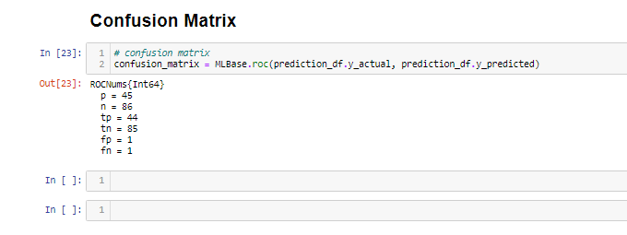
Fig: Confusion Matrix
- Total Positive: 45
- Total Negative: 86
- True Positive: 44
- True Negative: 85
- False Positive: 1
- False Negative: 1

Slide 18

Conclusion
In conclusion, Machine Learning is rapidly growing field in computer science. It has applications in nearly every other field of study and it is already being implemented.

Slide 19


Thank You.

